Slide 1

Chapter 13
Wired LANs:
Ethernet
School of Computer Science and Engineering
Pusan National University
Jeong Goo Kim

Slide 2
Ch. 13 Outline
    Outline
13.1 Ethernet Protocol
13.2 Standard Ethernet
13.3 Fast Ethernet
13.4 Gigabit Ethernet
13.5 10 Gigabit Ethernet

Slide 3
    13.1 Ethernet Protocol
    13.1 Ethernet Protocol
was developed at Xerox PARC between 1973 and 1974.
was inspired by ALOHAnet, which Robert Metcalfe had studied as part of his PhD dissertation
is based on CSMA/CD
Metcalfe named it after the disproven Luminiferous ether as an “omnipresent, completely-passive medium for the propagation of electromagnetic waves.”
By 2010, the market for Ethernet equipment amounted to over $16 billion per year.

Slide 4
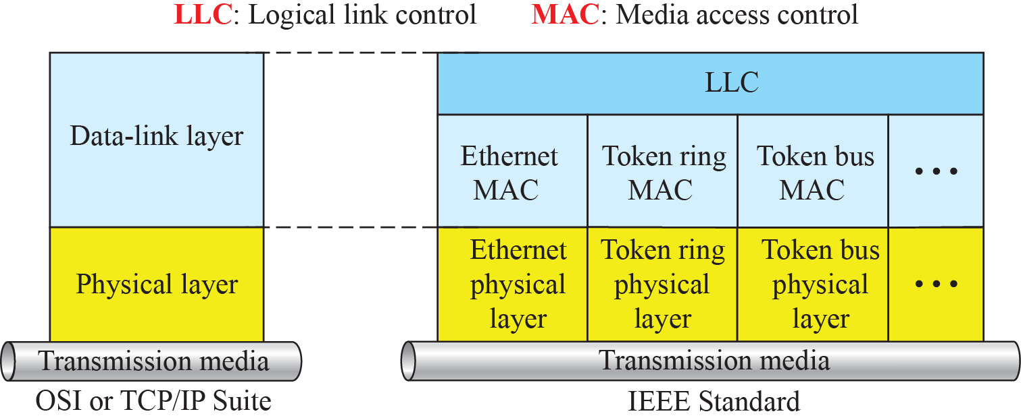
    13.1 Ethernet Protocol
    13.1.1 IEEE Project 802
In 1985, the Computer Society of the IEEE started a project, called Project 802, to set standards to enable intercommunication among equipment from a variety of manufacturers.
Fig. 13.1 IEEE standard for LANs

Slide 5
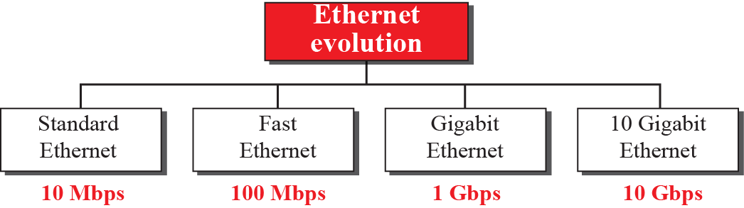
    13.1 Ethernet Protocol
    13.1.2 Ethernet Evolution
Fig. 13.2 Ethernet evolution

Slide 6
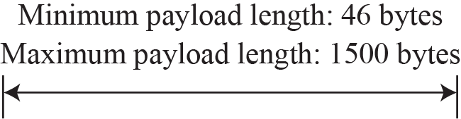
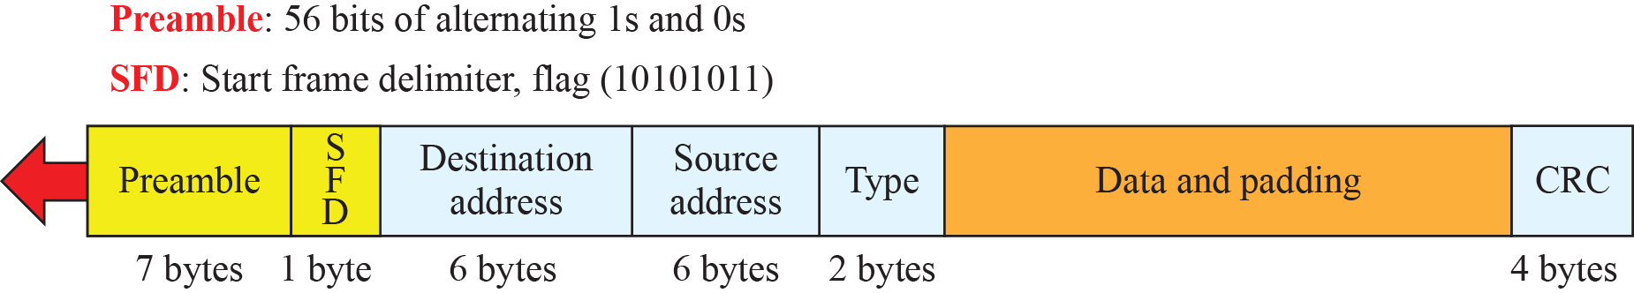
    13.2 Standard Ethernet
    13.2 Standard Ethernet
    13.2.1 Characteristics
    Fig. 13.3 Ethernet frame

Slide 7

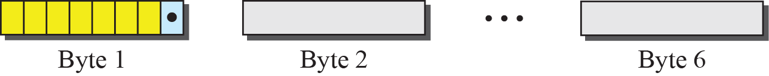
    13.2 Standard Ethernet
    13.2.2 Addressing
The NIC(network interface card) provides the station with a 6-byte link-layer address.
    Ex. 13.2
4A:30:10:21:10:1A 47:20:1B:2E:08:EE FF:FF:FF:FF:FF:FF
    Fig. 13.4 Unicast and multicast addresses

Slide 8
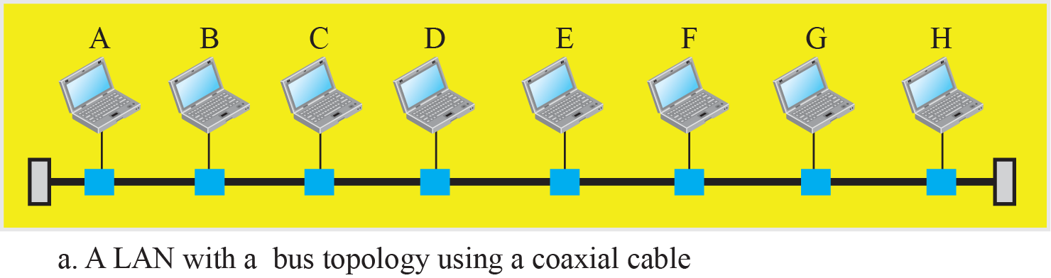
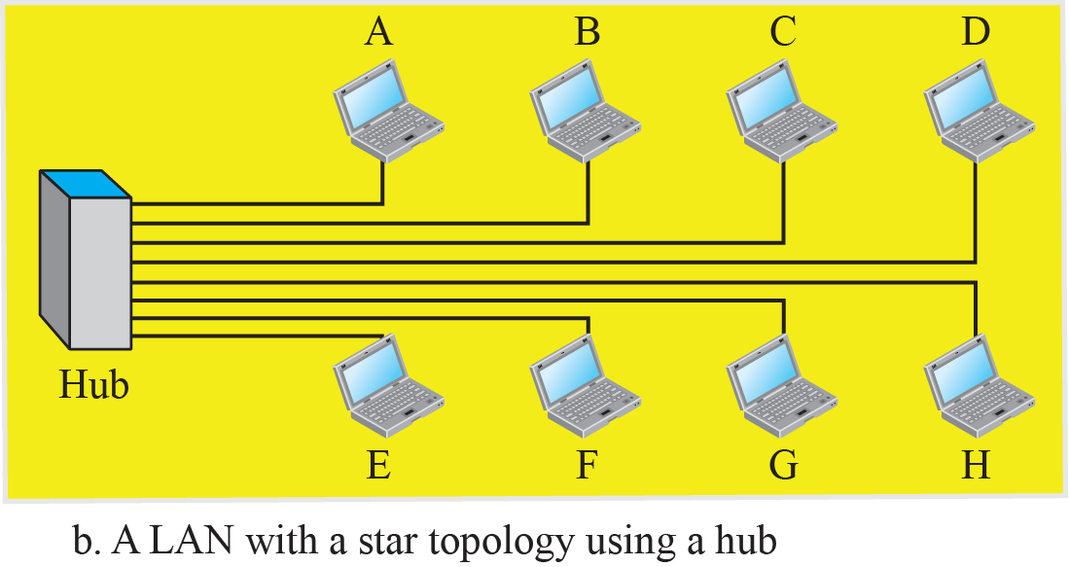
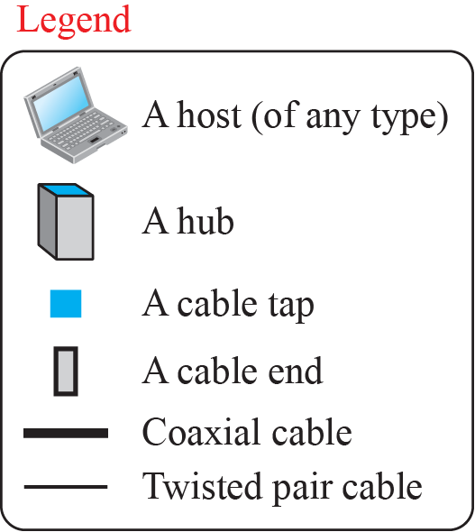
    13.2 Standard Ethernet
    Fig. 13.5 Implementation of standard Ethernet

Slide 9
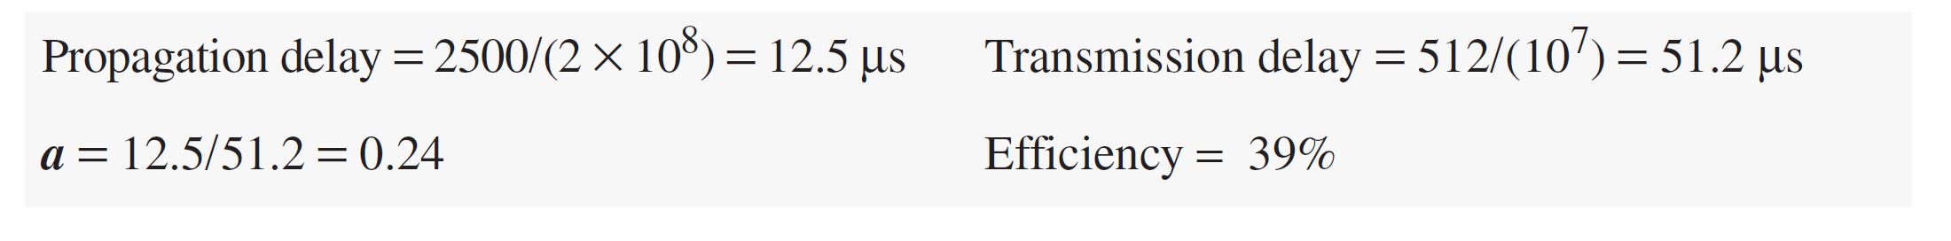
    13.2 Standard Ethernet
    13.2.3 Access Method
CSMA/CD with 1-persistent method
    13.2.4 Efficiency of Standard Ethernet
Efficiency = 1 / (1 + 6.4 × a )
  here, a = (propagation delay) / (transmission delay)
  and means the number of frames that can fit on the medium
    Ex. 13.3

Slide 10
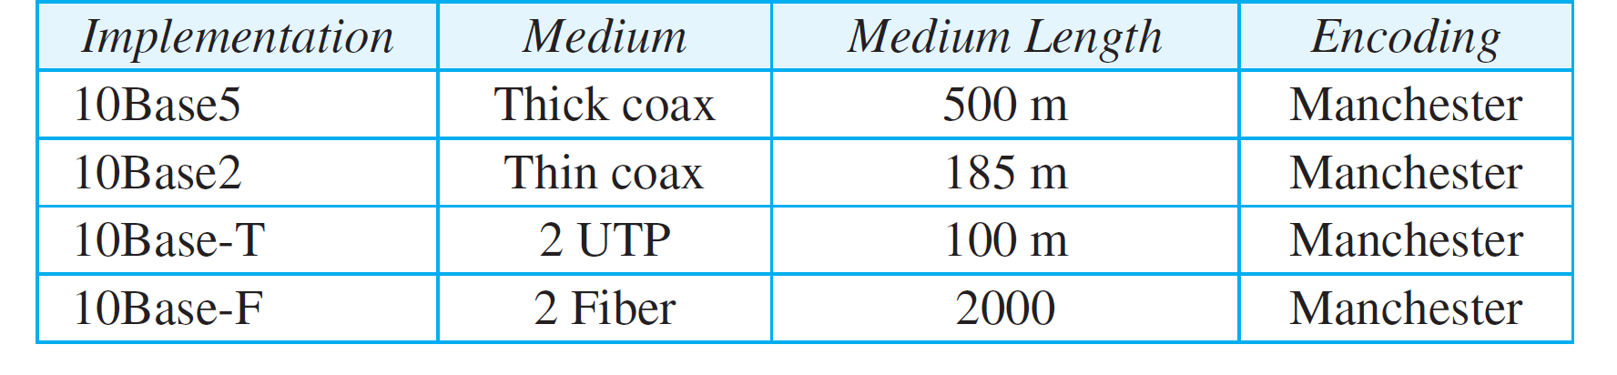
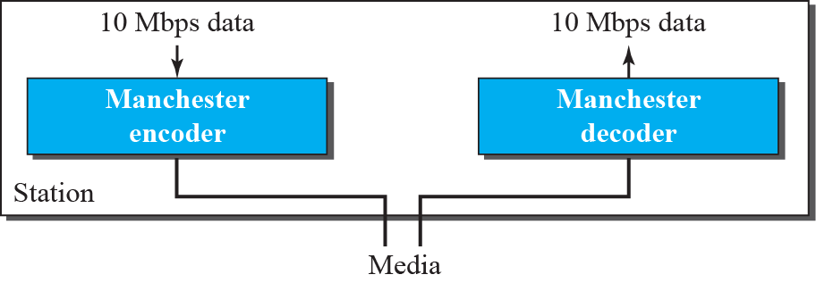
    13.2 Standard Ethernet
    13.2.5 Implementation
    Table 13.1 Summary of standard Ethernet Implementation
    Encoding and Decoding
    Fig. 13.6 Encoding in a Standard Ethernet

Slide 11
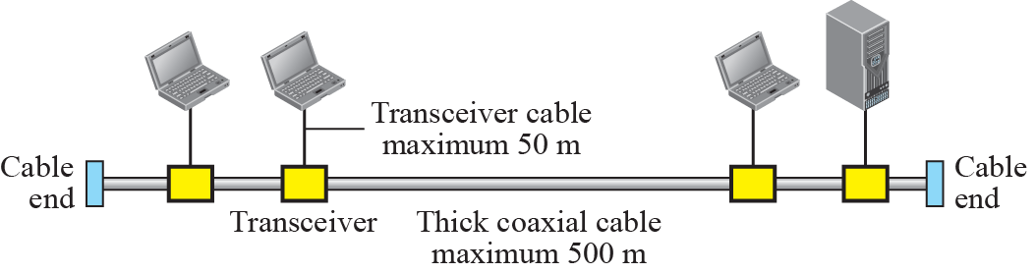
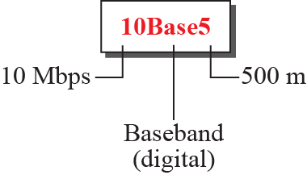
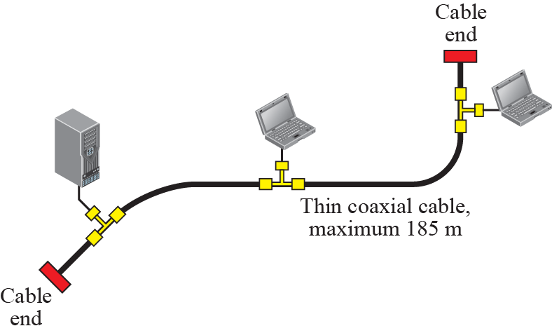
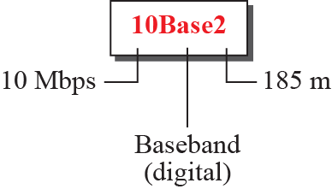
    13.2 Standard Ethernet
    10Base5: Thick Ethernet
    Fig. 13.7 10Base5 implementation
    10Base2: Thin Ethernet
    Fig. 13.8 10Base2 implementation

Slide 12
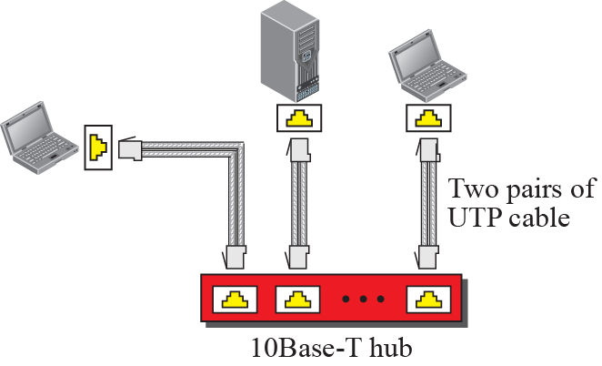
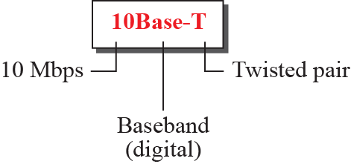
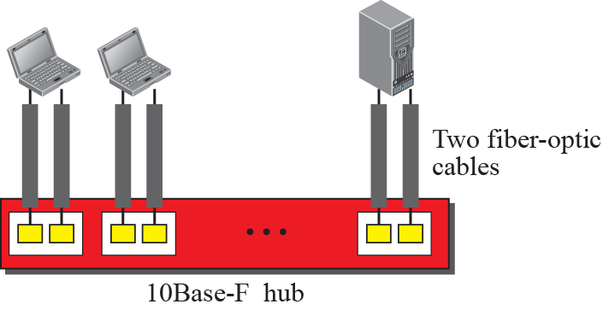
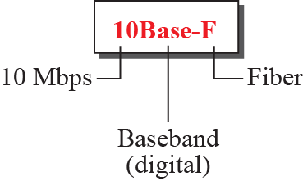
    13.2 Standard Ethernet
    10Base-T: Twisted-Pair Ethernet
    Fig. 13.9 10Base-T implementation
    10Base-F: Fiber Ethernet
    Fig. 13.8 10Base2 implementation

Slide 13
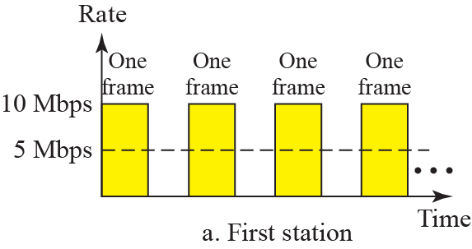
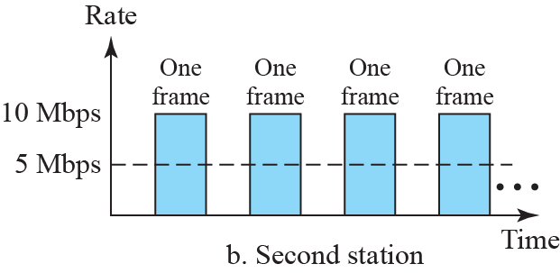
    13.2 Standard Ethernet
    13.2.6 Changes in the Standard
evolution of the Ethernet to become compatible with other high-data-rate LANs.
Bridged Ethernet
Raising the Bandwidth
Separating Collision Domains
    Ex. 13.11 Sharing bandwidth

Slide 14
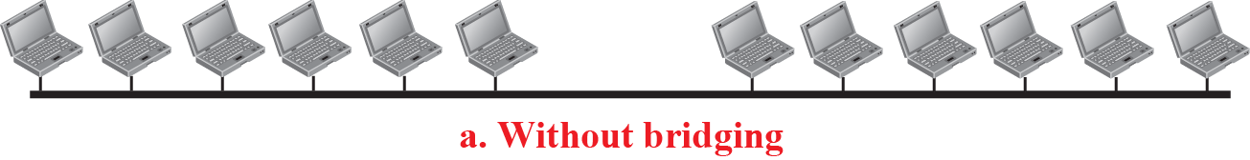
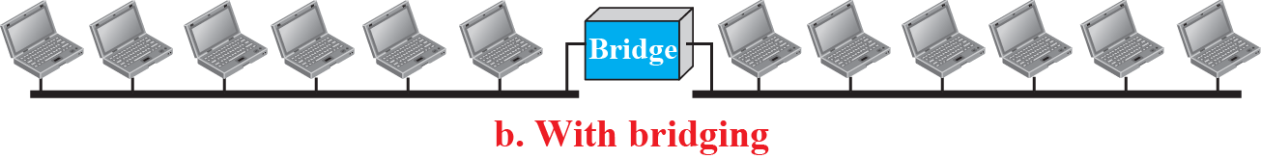
    13.2 Standard Ethernet
    Ex. 13.12 A network with and without bridging

Slide 15
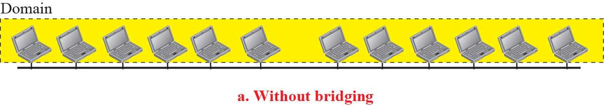
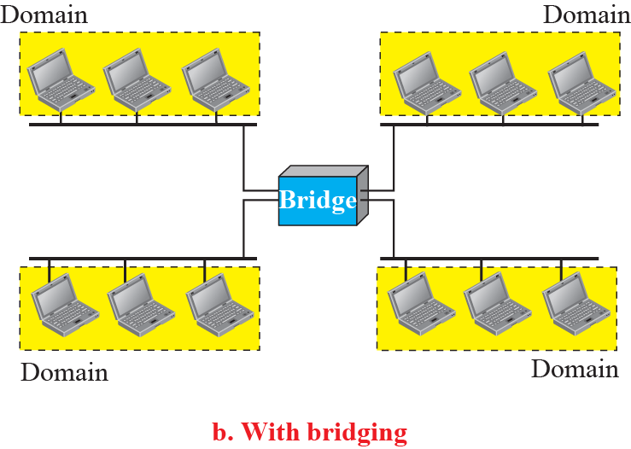
    13.2 Standard Ethernet
    Ex. 13.13 Collision domains

Slide 16
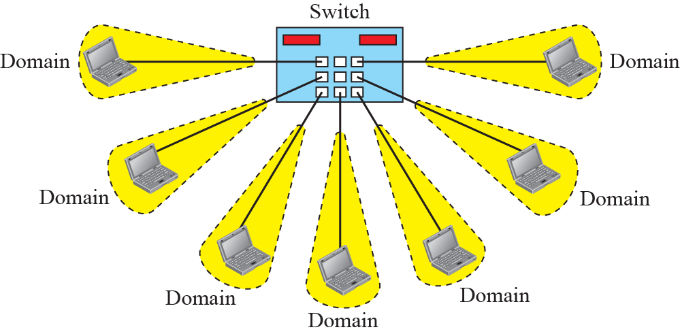
    13.2 Standard Ethernet
Switched Ethernet
    Ex. 13.14 Switched Ethernet

Slide 17
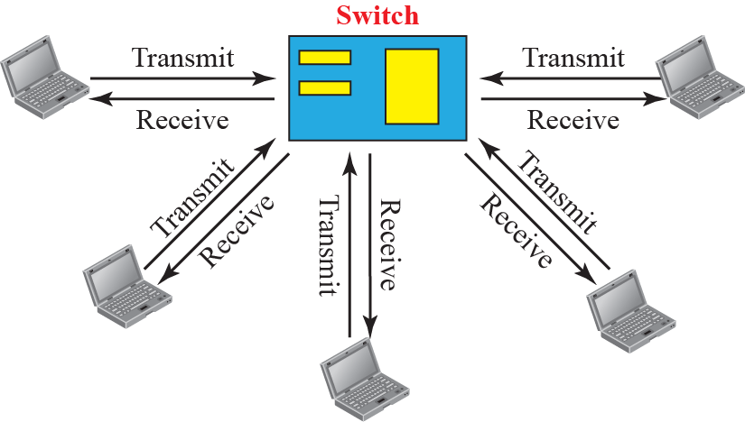
    13.2 Standard Ethernet
Full-Duplex Ethernet
No Need for CSMA/CD
MAC Control Layer
    Ex. 13.15 Full-duplex switched Ethernet

Slide 18
    13.3 Fast Ethernet
    13.3 Fast Ethernet
In the 1990s, Ethernet made a big jump by increasing the transmission rate to 100 Mbps.
to compete with higher transmission rate LAN such as FDDI.
The goals of Fast Ethernet
  upgrade the data rate to 100 Mbps
  Make it compatible with Standard Ethernet
  Keep the same 48-bit address
  Keep the same frame format

Slide 19
    13.3 Fast Ethernet
    13.3.1 Access Method
passive hub and star topology, limit to 250m
link-layer switch with full-duplex connection
Autonegotiation
To allow incompatible devices to connect to one another
To allow on device to have multiple capabilities
To allow a station to check a hub’s capabilities

Slide 20
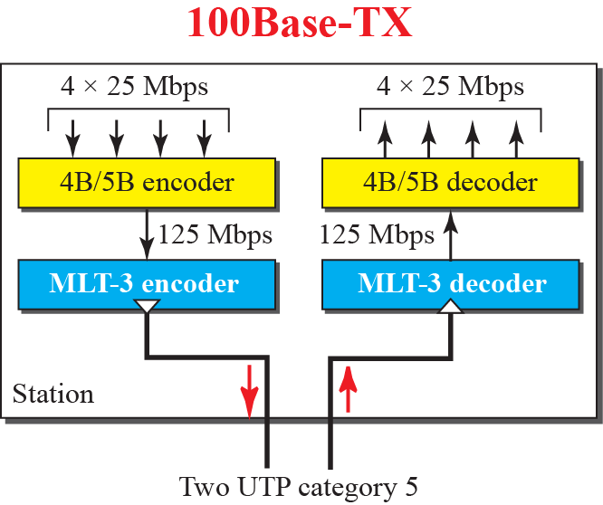
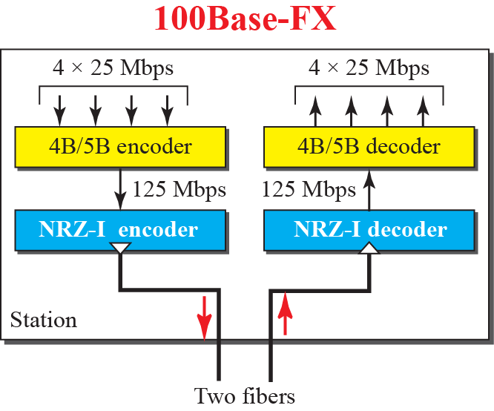
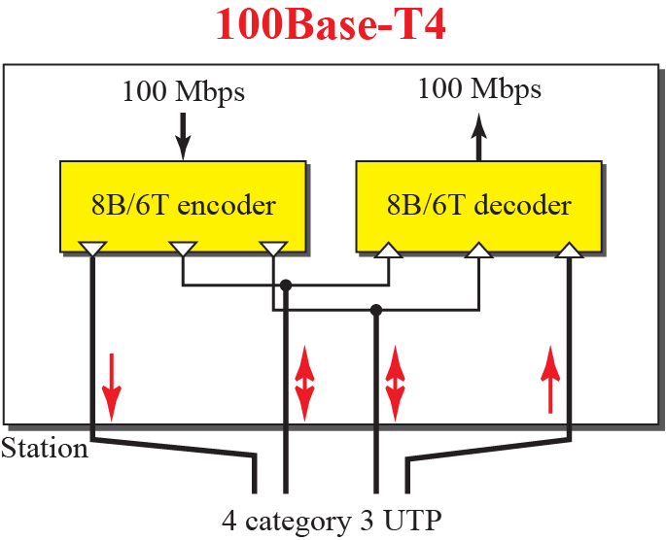
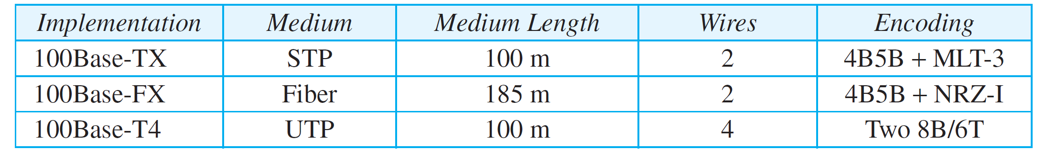
    13.3 Fast Ethernet
    13.3.2 Physical Layer
Fig. 13.16 Encoding for fast Ethernet
Table 13.2 Summary of Fast Ethernet implementation

Slide 21
    13.4 Gigabit Ethernet
    13.4 Gigabit Ethernet
IEEE standard 802.3z
upgrade the data rate to 1 Gbps,
keep the address length, the frame format, and the maximum and minimum frame length the same.
support autonegotiation as defined in Fast Ethernet
    13.4.1 MAC Sublayer
full-duplex
  no collision, no CSMA/CD
  allmost all implementation
half-duplex
  rare
  collision might be occur, CSMA/CD should be used

Slide 22
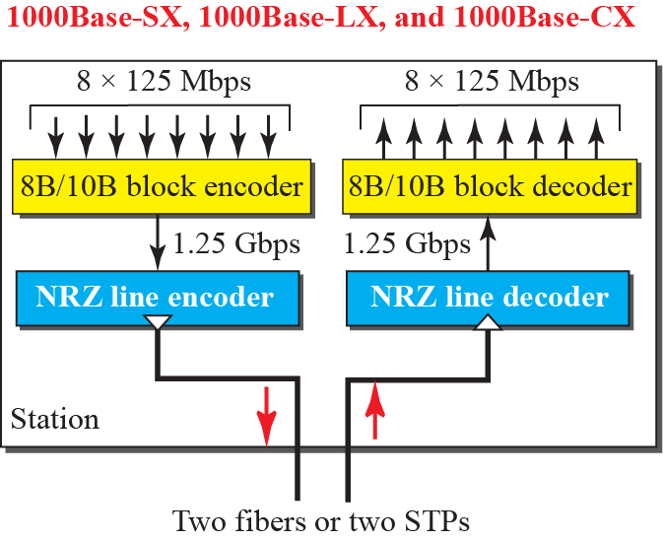
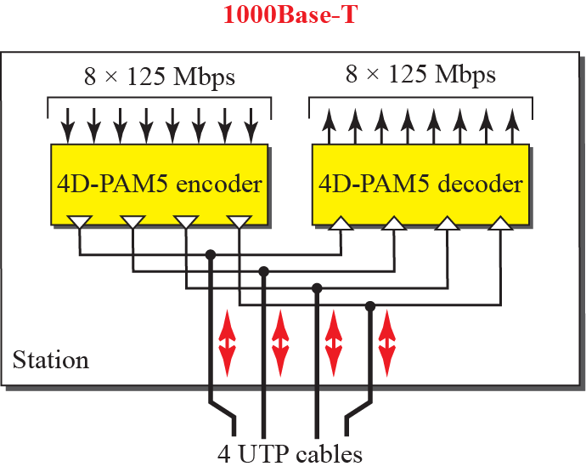
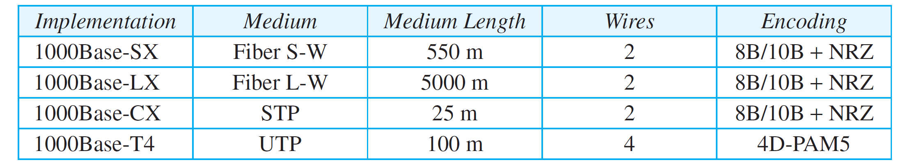
    13.4 Gigabit Ethernet
    13.4.2 Physical Sublayer
Fig. 13.17 Encoding in Gigabit Ethernet
Table 13.3 Summary of Gigabit Ethernet implementation

Slide 23
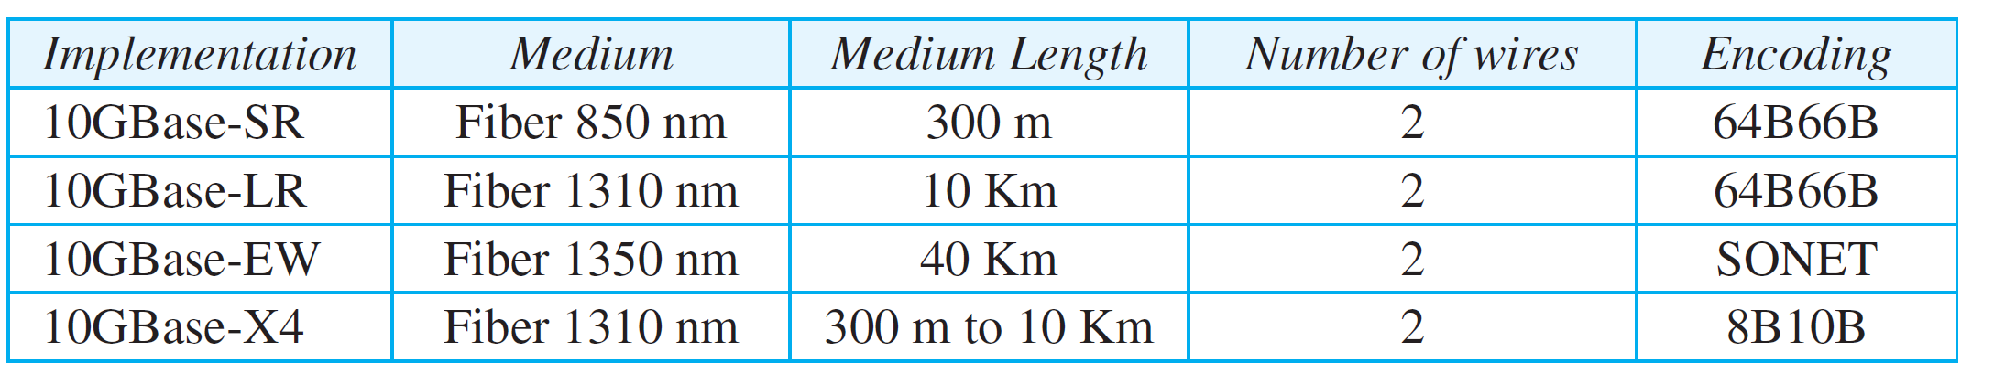
    13.5 10-Gigabit Ethernet
    13.5 10-Gigabit Ethernet
upgrade the data rate to 10 Gbps
IEEE standard 802.3ae
enlarge the coverage distance to metropolitan areas.
    13.5.1 Implementation
full-duplex
  no collision, no CSMA/CD
Table 13.3 Summary of 10-Gigabit Ethernet implementation

Slide 24
    Homework
Homework
Solve Problems P13-3, P13-3, P13-5, P13-8, P13-10
Read textbook pp. 387-432
Next Lecture
Chapter 14. Other Wired Networks

